Slide 1

Training – Testing Basics

Slide 2
Agenda
Definition
Testing Levels
Testing Approaches
Testing Types

Slide 3
Testing Basics
¿Testing?

Slide 4
Testing Basics
IEEE’s Definition
Is the process of operating a system or a system component to evaluate specific aspects under specific conditions, observing and registering the results.
The testing of software is the process of executing a program with the intention of finding errors.
A good test case is that which is likely to find an error
A successful test case is that which discovers a new error (Meyers)
“The process of executing a program with the intention of certifying its quality” (Mills)
Testing a program is exercising it with the worst intentions to find errors.
Testing is the art of destroying something constructively

Slide 5
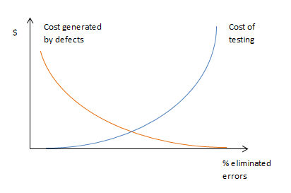
Testing Basics
Economy of a test
It is not possible to execute 100% of all the possible tests, to continue testing is an economic decision.
Finding a balance between the cost of the pending tests and the cost that could be generated by the pending bugs to be yet discovered.

Slide 6
Testing Basics
¿Why is testing necessary?
Because errors exist…Testing helps us to:
reduce the defects in Production
mitigate risk
make sure the code is reliable
improve/increase the product quality
ensure that the product fits the customer´s requirements
redefine the way things are done and how they work
set projects up to success
As time passes, the cost of fixing a defect increases.

Slide 7
Testing Levels
¿Testing Levels?

Slide 8








Testing Levels – V-Model
User Requirements
Acceptance Test Execution
Business
System Requirements
System test Execution
Global Design (Design / Architecture)
Integration Test Execution
Detailed Design
Component Test Execution
Technical
Implementation
Notes:
Component Testing Sample Bugs:
Un método o función que da error o no funciona como debería
Un flujo de código que nunca se ejecuta
Integration Testing Sample Bugs:
Inconsistencies in interactions or interfaces
Bad exception management
Wrong I/O rules in the interfaces
System Testing Sample Bugs:
All types of bugs, functional, non-functional
Client requirement not met
Slow performance
Incompatibility with certain browser
Acceptance Testing Sample Bugs:
The main objective is not to find defects and should answer: “can the system be released?”, “has the development met their obligations?”
Requirements misunderstandings can be discovered
Sometimes possible enhancements come up that aren´t exactly bugs

Slide 9
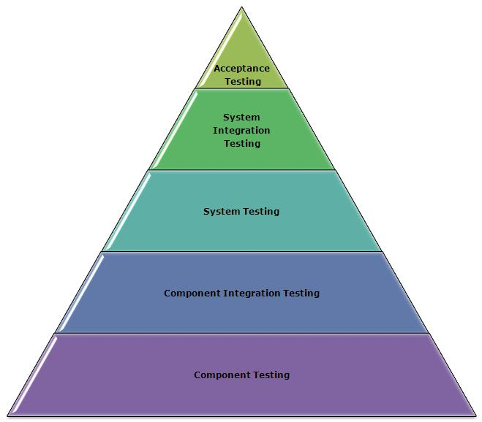
Testing Levels
End Users
Independent Testers
Developers

Slide 10
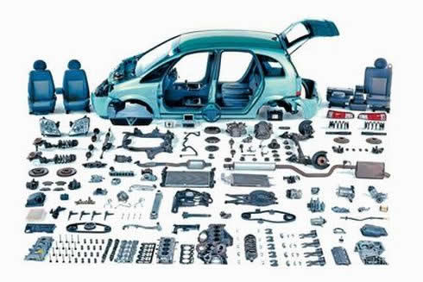
Testing Levels
Unit Test
The tests are executed against static code.
Unit tests verify functionality of a small subset of the system, such as an object or method
The developer who developed the code is involved.
The defects are fixed as soon as they are detected, without needing to go through the bug reporting formalities.
The goal is to find defects and to verify the software works by separately checking: Modules, Objects, Classes or Functions
The coverage is measured in % of code covered.
A failing unit test can go undiscovered by QC.
Notes:
Unit tests ensure quality by helping the programmer understand exactly what the code needs to do, and by providing guidance in the right design. They help the team to focus on the story that's being delivered and to take the simplest approach that will work.

Slide 11
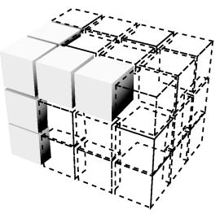
Testing Levels
Integration Test
Identifies problems that may arise when the different units are combined.
Two levels of integration testing exist:
  Component Integration: Looks for defects around the interfaces and interaction between integrated components.
  System Integration: Tests the interaction between different systems, can be part of the System Testing.
When the integration between the different components
is greater, it becomes harder to identify the interface
causing the error.
  Approaches: Big Bang, Incremental, Top-Down, Bottom-Up.
Notes:
Big Bang – May be difficult to understand which module or component caused de bug.
Incremental – It is easy to understand which component caused the bug, it should be the last one added.
Sample of component integration: In a library system we can test the Reservations module individually and it may pass all tests, we can test the book loans module individually and it may pass all tests, then we can integrate both modules and test that when a book is loaned the corresponding reservation is cancelled to make sure both modules communicate and interact correctly.
Sample of system integration: We can test the application with mocked data and verify the display of the information is correct, we can test a web service and verify the information gathered and manipulated is correct, then we can integrate both systems and verify the application can send a request to th web service and receive a response and display the data correctly on screen.

Slide 12

Testing Levels
System Test
Executed by a team of testing specialists based on:
  Requirements
  Use Cases or User Stories
  Risks
  Business processes
Is the final test to verify and validate that the system meets the specifications.
The goal is to find the most defects.
Must include functional and non-functional requirements.
Must be executed in a controlled environment.

Slide 13
Testing Levels
End-to-End Test
Similar to system test, involves testing of a complete application environment in a situation that mimics real-world use, such as interacting with a database, using network communications, or interacting with other hardware, applications, or systems if appropriate

Slide 14

Testing Levels
Acceptance Test
Focuses mainly on validating that the system meets the operational expectations.
Is executed by the client himself or by system users. Users
QCs often have to provide support to the users in this phase.
The goal in this case is not to find defects, but to gain
confidence on the system.
There are two types of Acceptance Tests:
  Alpha Test: is executed in a controlled development
  environment
  Beta Test: is executed in the clients environment, under
  real world conditions.

Slide 15
Testing Approaches
¿Testing Approaches?

Slide 16
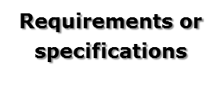





Testing Approaches
Test Cases
Test Cases

Slide 17
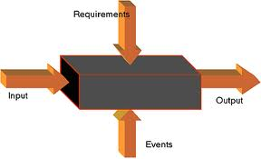
Testing Approaches
Black Box Tests
Tests what the software should do.
It is based on the module’s definitions and specifications.
It does not care about the program’s internal structures or behaviors
Functional test, produced by data, inputs and outputs.

Slide 18
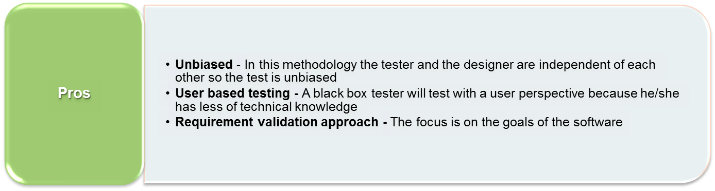
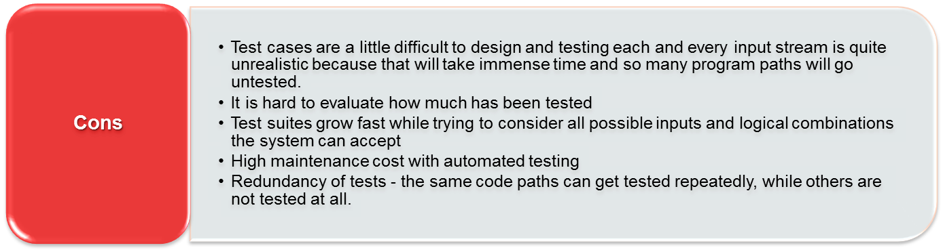
Testing Approaches
Black Box Tests

Slide 19

Testing Approaches
White Box Tests
Tests what the software does.
Test cases are designed considering the software’s internal structure.
function FastExp (x, y: int): int;
% pre: y >= 0
% post: devuelve x a la y
z :int :=1;
while y <> 0 do
if odd(y) then
z := z * x;
y := y - 1
endif;
x := x * x;
y :=y / 2
endwhile
return(z)

Slide 20
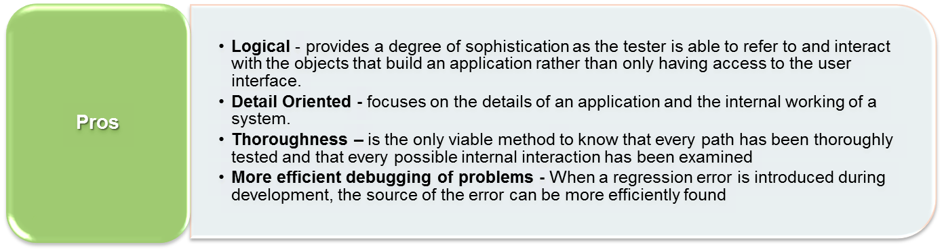
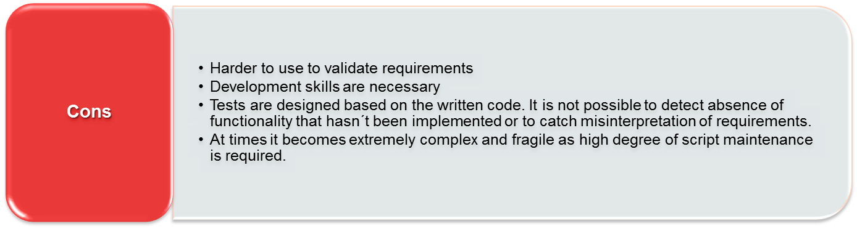
Testing Approaches
White Box Tests

Slide 21
Testing Approaches
Positive
  Verifies the ability of the system to implement a solution to the business needs under normal conditions
  +
  Negative
  Verifies the ability of the system to detect, document and resolve user errors or any other condition not considered normal
  -
Vs.
Notes:
Positive Tests – Happy Path
Negative Tests – All error related scenarios

Slide 22
Testing Approaches
  Manual
  Tests that are manually executed by testers, which walk through the system step by step in search of defects
  Automatic
  Tests that are automatically executed by specially designed tools, which require minimum tester supervision.
  Nevertheless, there is always some degree of manual testing needed.
Vs.
Notes:
Tests that are to be executed repeatedly should be automated
Even if most tests are automated we still need to have QCs to kick off the tests, to analyze and verify the results, to update the tests with any changes in the system and to report and follow up on bugs.

Slide 23
Testing Types
¿Testing Types?

Slide 24
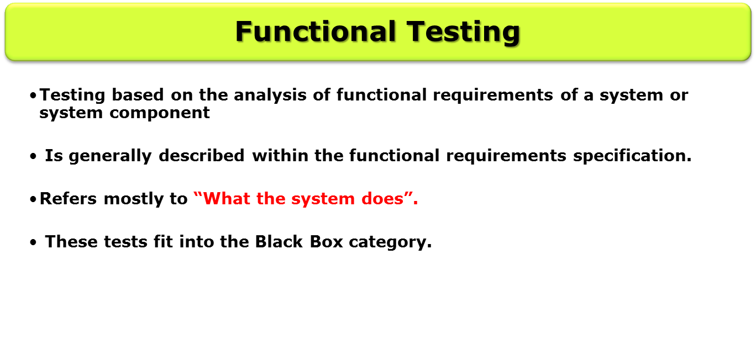

Testing Types

Slide 25
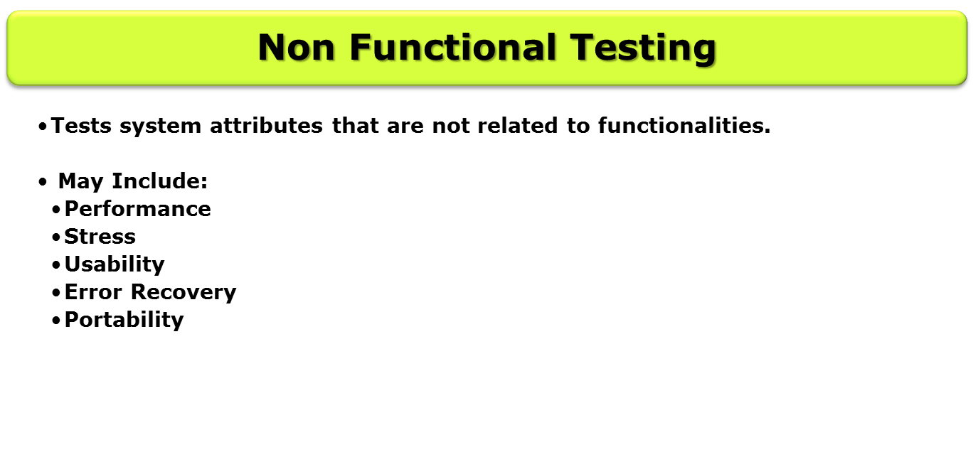

Testing Types
Notes:
Usability – How easy is the system to use? to learn by new users? is it intuitive? Is it consistent (steps to complete tasks, how messages are displayed)?
Portability – Is is compatible with different operating systems, with different browsers? How easy is the system installed?

Slide 26
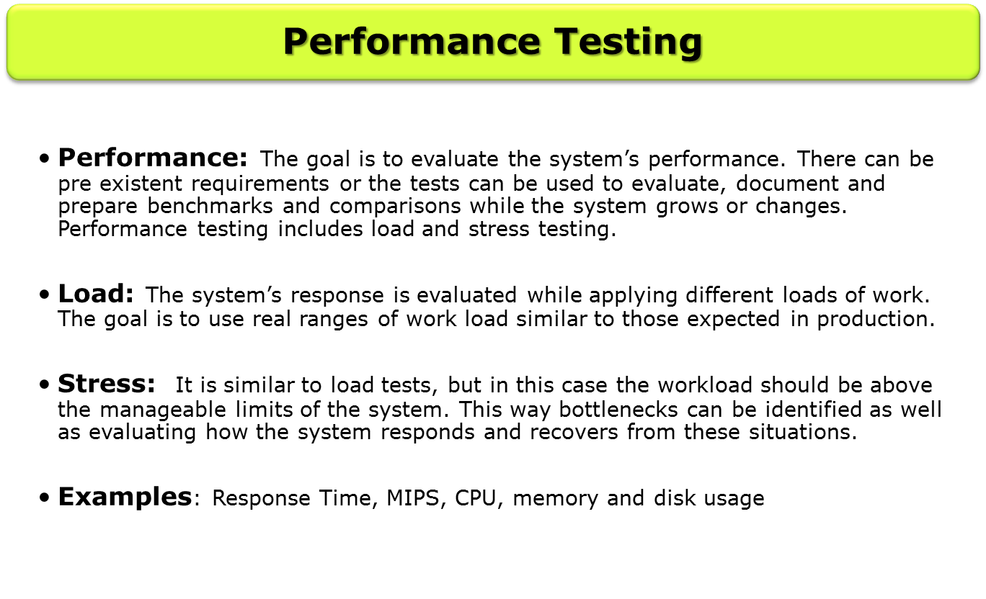
Testing Types

Slide 27
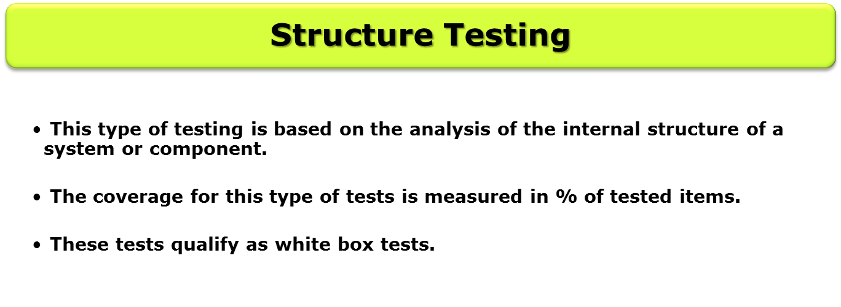
Testing Types

Slide 28
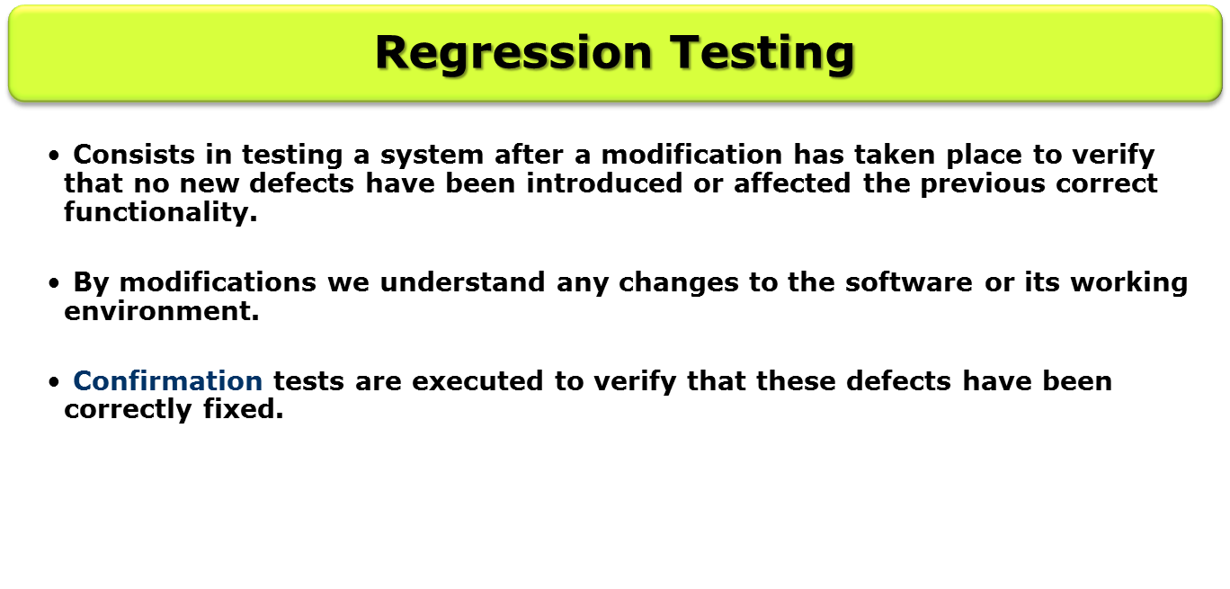

Testing Types

Slide 29
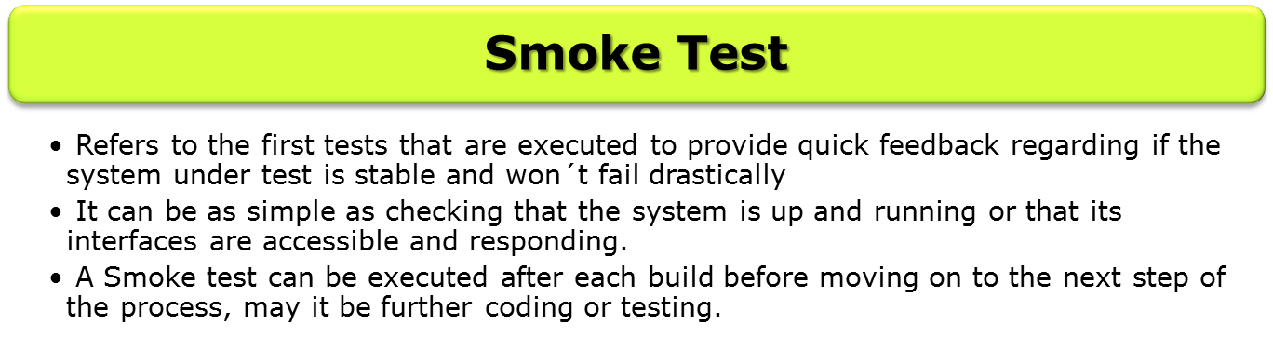
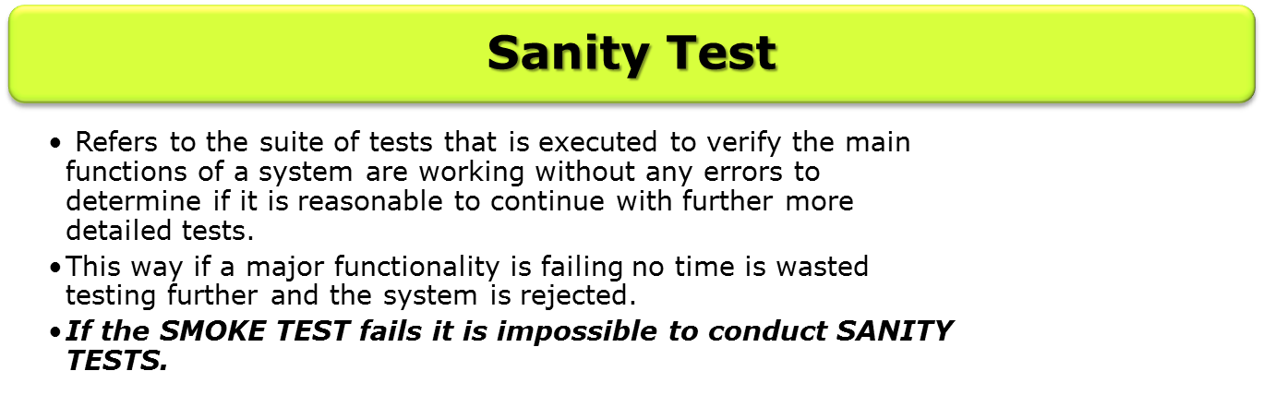

Testing Types

Slide 30
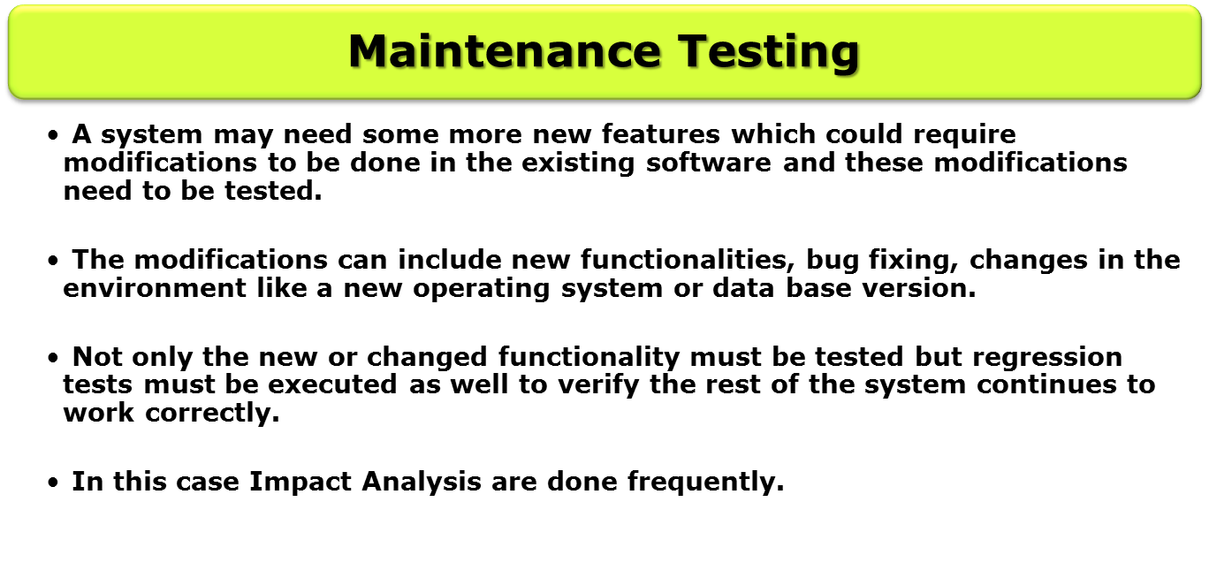

Testing Types

